Slide 1
Insuring Your Teen Driver
Risks, Suggestions and Insurance Considerations
Presented by:
Notes:
As teenagers count the days until they get their drivers’ licenses, many parents also count the days in dread. Teens acquire freedom and a chance to hit the open road. Parents, on other hand, face sleepless nights and higher premiums for their auto insurance. Nervous parents have a right to be concerned, as teen drivers pose many dangers to themselves and others on the road.

Slide 2
Teen Driver Statistics
2,163 teens ages 16 to 19 died from injuries caused by motor vehicle crashes in 2013.
243,243 teens ages 16 to 19 involved in automobile accidents sustained nonfatal injuries that were severe enough to require treatment in the emergency room in 2013.
The risk of motor vehicle accidents is higher among 16- to 19-year-olds than among any other age group—they are nearly three times more likely to crash than older drivers.
The motor vehicle death rate for male drivers ages 16 to 19 is normally two times that of female teenage drivers.
Teenage drivers are most likely to have an accident during their first year of driving.
Source: Centers for Disease Control and Prevention (CDC)
Notes:
According to the Centers for Disease Control and Prevention (CDC), motor vehicle crashes are the leading cause of death of American teens, accounting for over 30 percent of all deaths in this age group. Here are some other statistics on teen drivers.

Slide 3
Risks for Teen Drivers
Teens get into motor vehicle accident for the following reasons:
Teens underestimate hazardous or dangerous situations, or are not able to recognize potentially hazardous situations.
Teens are more likely to speed and to follow too closely to the driver in front of them. Males tend to do these behaviors more than females.
Teens have the lowest seat belt use of all drivers.

Slide 4
Risks for Teen Drivers
Teens get into motor vehicle accident for the following reasons:
Teens have a greater danger of getting into accidents between 9 p.m. and 6 a.m. because of a lack of night driving experience.
Teens succumb to peer pressure from passengers to drive dangerously such as speeding or racing with other vehicles.
The National Institute of Mental Health claims that the part of the brain that weighs risks, makes judgment decisions and controls impulses is not fully developed until age 25.

Slide 5
Risks for Teen Drivers
Teens get into motor vehicle accident for the following reasons:
Teens with a blood alcohol level (BAC) of any concentration are at a greater risk of crashing compared to older drivers.
Over half of all teen drivers use cell phones while driving, which inhibits their ability to drive safely.

Slide 6
Accidents by Age of Drivers
Age group | Number of drivers | Percent of total | Drivers in fatal accidents | Percent of total | Drivers in all accidents | Percent of total
Under 20 | 10,326,000 | 4.9% | 3,900 | 8.1% | 2,020,000 | 12.2%
20-24 | 17,465,000 | 8.3% | 6,300 | 13.1% | 2,480,000 | 15.0%
25-34 | 36,694,000 | 17.4% | 8,800 | 18.3% | 3,270,000 | 19.8%
35-44 | 38,424,000 | 18.2% | 7,500 | 15.6% | 2,910,000 | 17.6%
45-54 | 41,921,000 | 19.9% | 8,300 | 17.3% | 2,750,000 | 16.7%
55-64 | 33,271,000 | 15.8% | 5,900 | 12.3% | 1,710,000 | 10.4%
65-74 | 19,135,000 | 9.1% | 3,500 | 7.3% | 820,000 | 5.0%
Over 74 | 13,764,000 | 6.5% | 3,800 | 7.9% | 540,000 | 3.3%
Total | 211,000,000 | 100.00% | 48,000 | 100.00% | 16,500,000 | 100.00%
Note: Percentages do not add up exactly because of rounding. Source: U.S. Census Bureau.

Slide 7
Graduated Drivers Licensing (GDL)
Teens gradually receive their drivers’ licenses in 3 phases:
Receive a supervised learners’ permit
Teens remain in this stage for an average of six months
Learners’ permit is required while driving with adult supervision
Must pass a vision and knowledge test before receiving intermediate license
Must always wear a seatbelt
Must have no traffic and/or alcohol offenses
Cannot drive at night
Receive an intermediate drivers’ license
Restrictions on the number of passengers allowed in the vehicle and night driving
Zero tolerance for alcohol offenses and traffic violations
Can drive unsupervised in limited situations
Full driving privileges granted
Notes:
Most states have adopted the Graduated Drivers Licensing (GDL) program to combat high fatality rates among teen drivers. This allows teens to gradually receiving driving privileges.

Slide 8
Graduated Drivers Licensing (GDL)
Benefits of GDL Programs:
CDC found that the GDL program in North Carolina reduced hospitalizations and hospital costs for teen drivers by more than one third.
Injury and fatality rates were 20 percent lower in states with passenger and nighttime driving restrictions.

Slide 9
Graduated Drivers Licensing (GDL)
Johns Hopkins Bloomberg School of Public Health found that states with the following elements in their GDL program had a 20 percent reduction in fatal crashes by 16-year old drivers:
Minimum age of 15 and one-half years old to receive learners’ permit
Waiting period of at least three months before applying for an intermediate license after receiving learners’ permit
Minimum of 30 hours of supervised driving
Must be at least 16-years-old before obtaining intermediate license
Must be at least 17-years-old before obtaining full license
Restrictions on number of passengers allowed in vehicles with teens

Slide 10
Suggestions for Parents
Enroll your child in a private driver education course taught by a professional.
Have your child obtain his/her learner’s permits as soon as possible and get as much experience as they can throughout the next year.
Require your child to drive with a learner’s permit for a full year, even if your state only requires this for six months.
Have your child practice driving under various conditions such as at night, during bad weather and in heavy traffic.
Notes:
In addition to abiding by your states’ laws regarding first-time drivers, including the restrictions of GDLs, parents can do many things to lessen motor vehicle hazards for their children.

Slide 11
Suggestions for Parents
Restrict the number of passengers allowed in the car with your teen driver. The more passengers, the greater the risk.
Do not allow your child to drive with new, teen drivers until they have had permits for at least one year.
Purchase a sensible, safe vehicle for your child to drive and/or allow them to drive one of your vehicles that fits that description.
Do not give your child his/her “own” car. Allow them to drive a “family vehicle” that is everyone’s to use. This will divert them from treating it more haphazardly.

Slide 12
Suggestions for Parents
Set firm rules about driving privileges and stick with them. Relax the rules as your child becomes a better driver and maintains a clean driving record.
Make sure your teen gets enough sleep before driving; this will lessen his/her chance for an accident.
Set a good example in your own driving by abiding traffic laws, not talking on a cell phone while driving and not carrying on in-depth conversations while on the road with your teen in the car.
Create a driving contract between you and your child.

Slide 13
Parent/Child Driving Contract
Driving contracts should satisfy the following:
Send the message that driving is a privilege that should be taken very seriously.
Eliminate any confusion about your rules regarding driving.
Provide consequences for children who break driving rules.

Slide 14
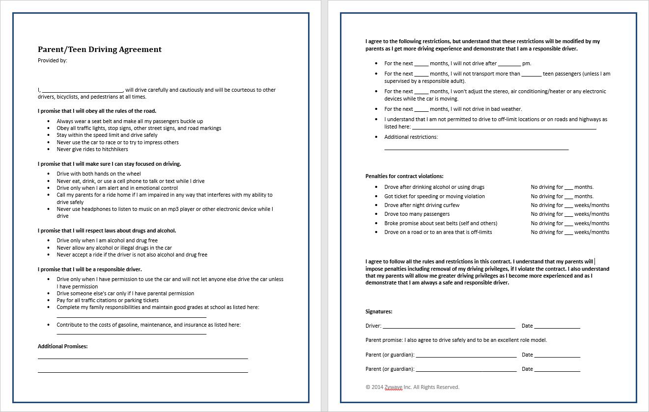

Slide 15
Parent/Child Driving Contract
Contracts should at least contain the following:
Curfew restrictions
Where the teen may/may not drive
Cellphone use, radio use, MP3 player use restrictions
Seat belt usage
Consequences of having or receiving accidents, tickets and fines
Consequences of driving under the influence of alcohol and/or drugs
Passenger restrictions
Consequences of violating any parts of the contract
Notes:
Draft a driving contract in which you and your child should both agree upon and sign. If your child violates the contract, you will already have established consequences in place and can enforce them without questions and refutes from your child.

Slide 16
Motor Vehicle Insurance
Automobile insurance is an absolute must!
When determining your buying limits, consider the following:
How much you can afford to pay in premiums
Your obligation to someone who is injured in an auto accident

Slide 17
Obtaining the Best Rates
How can consumers get the best rates for their teens?
Make sure teens attend driving schools approved by the insurance company. There are discounts for passing approved courses.
Teens should maintain at least a “B” average (3.0 or higher) in school. Ask about our “Good Student Discount.”
Select a higher deductible, which lowers your premium. Opting for a $250, $500 or $1,000 deductible can save a significant amount. Determine whether you can afford out-of-pocket costs in the event of an accident.
Pay for minor damages yourself.

Slide 18
Obtaining the Best Rates
Avoid buying teens their “own” vehicle; have them drive a family car instead. The car should be in solid mechanical order, a four-door vehicle and no less than five years old (avoids adding collision insurance). These cars are also less likely to be stolen and do better in crash tests.
Keep all cars in parents’ names because they typically have more assets, which equals lower premiums.
If parents have good driving records, add teens to their current policy and pay an increased premium. If parents’ driving records are spotty or they drive extremely expensive cars, it’s best to purchase a separate policy for teens.
Only assign teens to one, less expensive car. Do not, under any circumstances, allow them to drive cars that they are not insured under.

Slide 19
Obtaining the Best Rates
Check with Mountain State Insurance Agency, Inc. to see when we classify teens as adults and, consequently, lower premiums—this varies between age 23 to 25. At this time, check to see if teens should have their own policies.
Inquire about our safe driving programs. Teens go through the program and sign a contract promising not to drink and drive. Completion of these programs can reduce premiums.
Ask Mountain State Insurance Agency, Inc. about discounts for teens who go off to college at least 100 miles away and do not keep a car on campus.

Slide 20
Best Practices
Consider these best practices before your teen starts driving:
As soon as your teen is ready to get his/her learner’s permit, contact Mountain State Insurance Agency, Inc.. If your child gets into an accident, we will generally cover it but may charge a higher premium retroactively if you did not notify them that your child was driving. In rare cases, your coverage may be revoked.
Do not lower your liability coverage drastically to combat rate increases. It simply does not make sense to carry less liability for a high risk driver, like teens. Plus, you will be forced to cover damages out-of-pocket if your child gets into an accident without enough coverage.

Slide 21
Personal Liability Umbrella Policy
In addition to an automobile insurance policy, consider purchasing a Personal Liability Umbrella Policy (PLUP).
This policy will protect you against litigation if your teen accidentally injures someone or damages property. Even though your auto policy has substantial limits, it is common for juries to award damages that far exceed these limits.
PLUPs supplement existing policies to provide additional liability protection.

Slide 22
Questions and Comments
© 2008, 2012-2013, 2016 Zywave Inc. All rights reserved.
Please let us know how we can help you and your new teen driver!
Learn more at www.mountainstateinsurance.com
304-720-2000 Charleston
304-525-7821 Huntington

